Slide 1
Kharagpur Data Science Hackathon
Team Name - Harvey Mike
Institute - IIT Kharagpur

Slide 2
Table of Contents
01
02
03
04
Introduction
EDA
Solution
Final Results

Slide 3
01
Introduction

Slide 4
Problem Statement
Task - 1 (Classification Type)
Task - 2 (Regression Type)
Objective: Forecast the HCP's optimal channel among the three promotional channels of Sales Rep calls, emails, and Sample Drops for the coming week (first week of Feb'20)
Constraint: 1. Limit on calls in last 12 months according to HCP segment 2. Only 25% HCPs can be reached through sample drop
Objective: Predict the Brand Rx (prescriptions) for the coming week (first week of Feb'20) generated through the optimized channel.
Constraint: 1. Overall predicted Brand Rx (across all HCPs) should not deviate more than 10% from the immediate previous week

Slide 5
HCP Data Description
Physician ID
Samples Dropped
Unique ID of the physician/HCP
Number of Brand drug samples received by the HCP in that week
Brand Rx
Emails Delivered
Prescriptions for the brand medicine written by the HCP during that week
Number of emails delivered to the HCP through campaigns in that week
Market Rx
Physician Segment
Prescriptions for all Skin Disease market medications written that week by HCPs
A segment assigned for every HCP based on their value and relevance (Low, Medium, High)
Sales Rep Calls
Physician Speciality
Whether the HCP received a call from the salesperson during that week
Medical speciality of the HCP (Dermatologist, General Physician, Nurse Practitioner)

Slide 6
02
Exploratory Data Analysis (EDA)

Slide 7
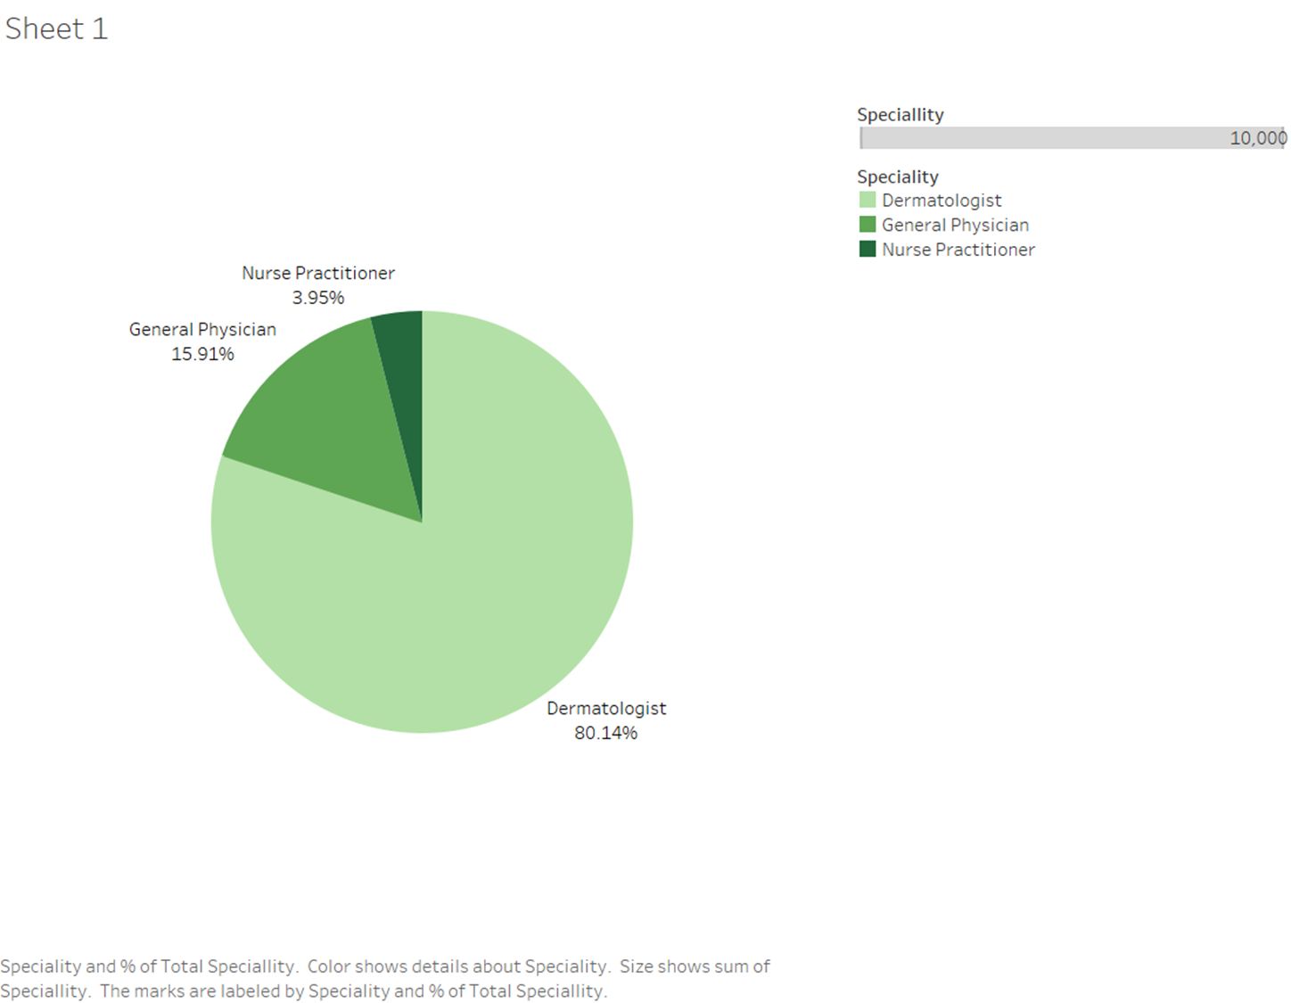
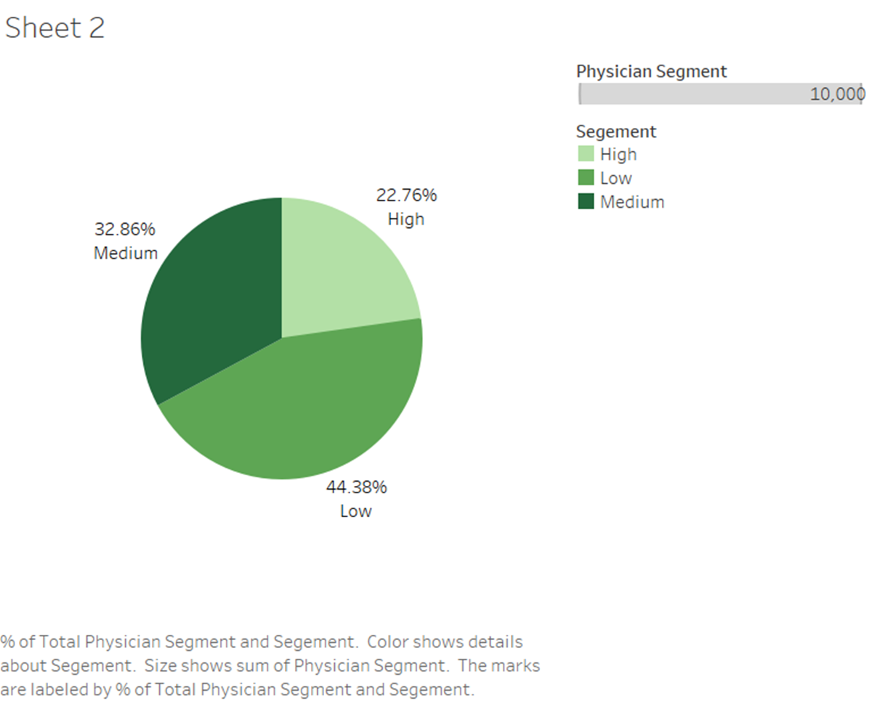
Distribution of HCP Data
Speciality of HCP
Segment of HCP

Slide 8
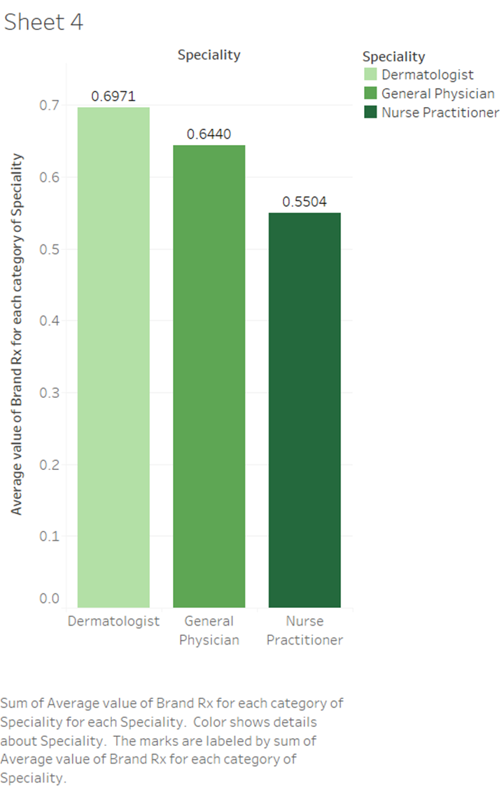
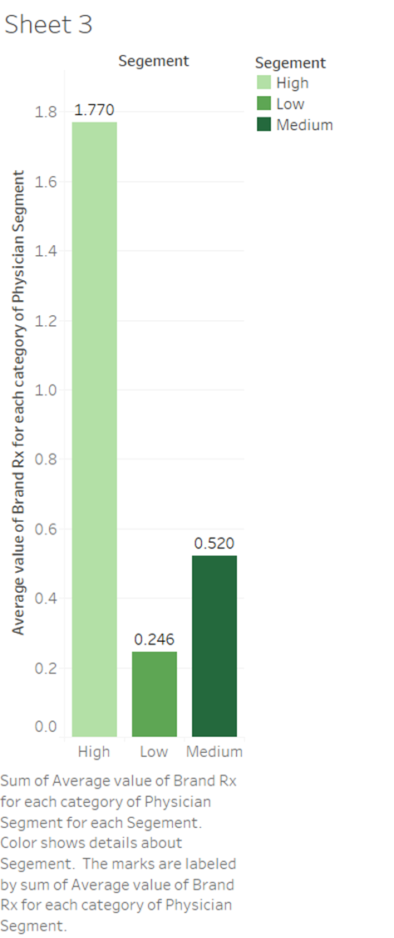
Influence on Brand Rx Value
Speciality of HCP
Segment of HCP

Slide 9
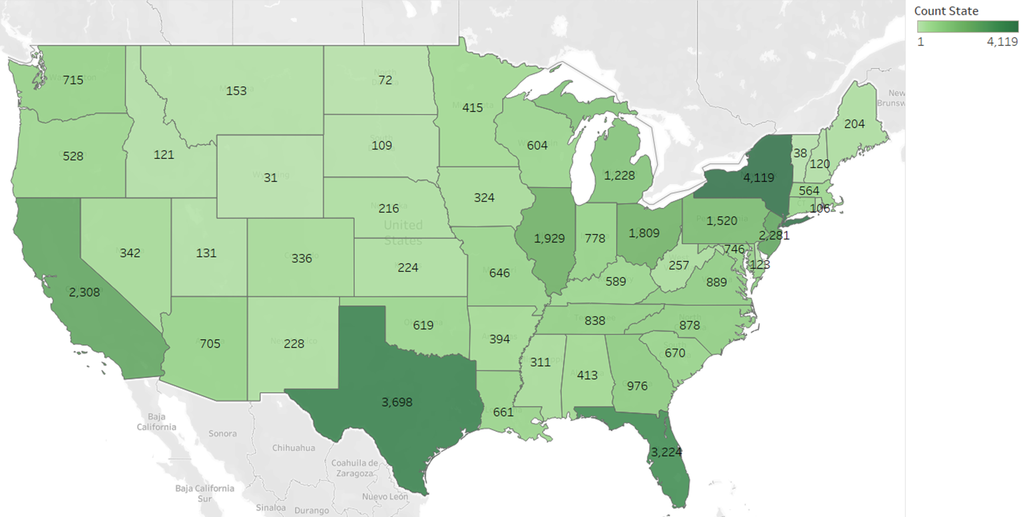
Geographical Distribution

Slide 10
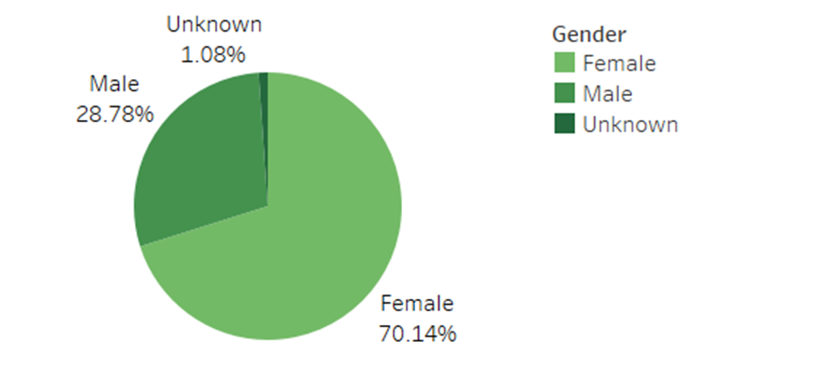
Data Observation
While observing data, we found 1324 HCPs with either all the promotions as null or Brand Rx value as null.
This could be due to the following reasons:
1. Values are missing
2. Brand Rx is zero even after multiple attempts to reach the HCP
3. Company doesn’t want to promote through that particular HCP
Females are found to be consuming this drug more often than Males.

Slide 11
03
Solution

Slide 12
Task - 1 (Classification Type)
Approach 1
Correlation of Brand Rx with Promotion strategy
VAR without constraint on Promotion strategy
Approach 2
Approach 3
VAR with constraint on Promotion strategy
Final Approach
Approach 4

Slide 13
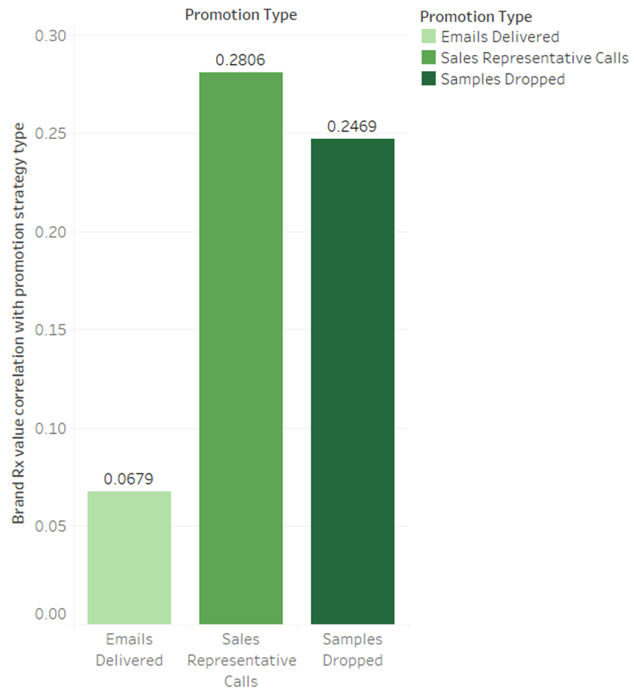
Approaches to Task - 1
A. Correlation of Brand Rx with Promotion strategy:
Sales representative calls has the highest impact, whereas emails barely impact the brand Rx.
For HCPs where either all Brand Rx values are zero or all promotion strategies are also zero. We believe calls is best option due to high correlation.

Slide 14
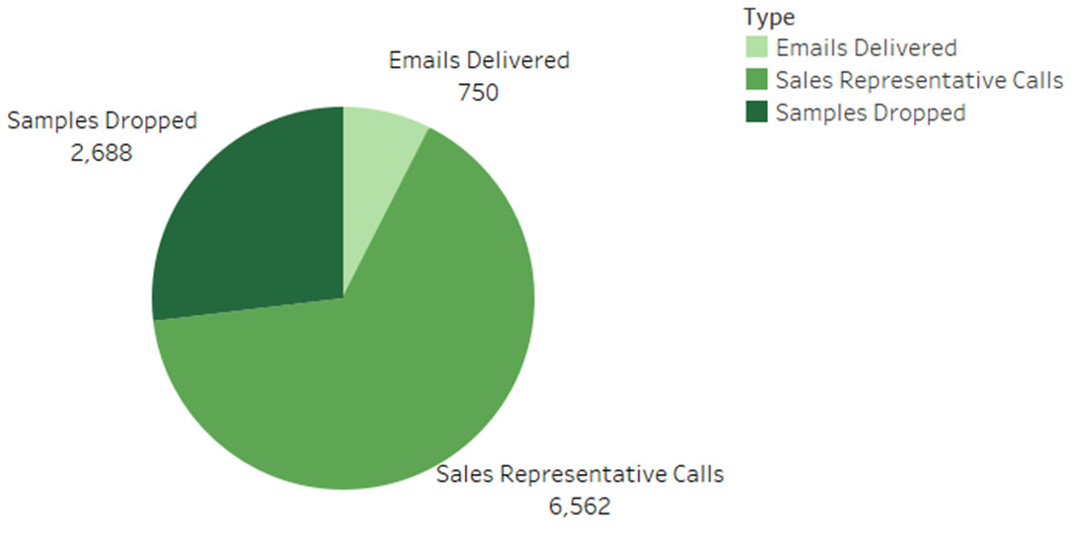
Approaches to Task - 1
B. VAR without constraint on Promotion strategy:
The number of calls, samples dropped and emails was predicted using Vector Autoregression (VAR) for each HCP.
This was done to see how model performs without constraints.
C. VAR with constraint on Promotion strategy:
Constraints were sequentially resolved, starting with calls followed by samples dropped, and if the condition on either of those were violated, we predicted the promotion strategy as email.

Slide 15
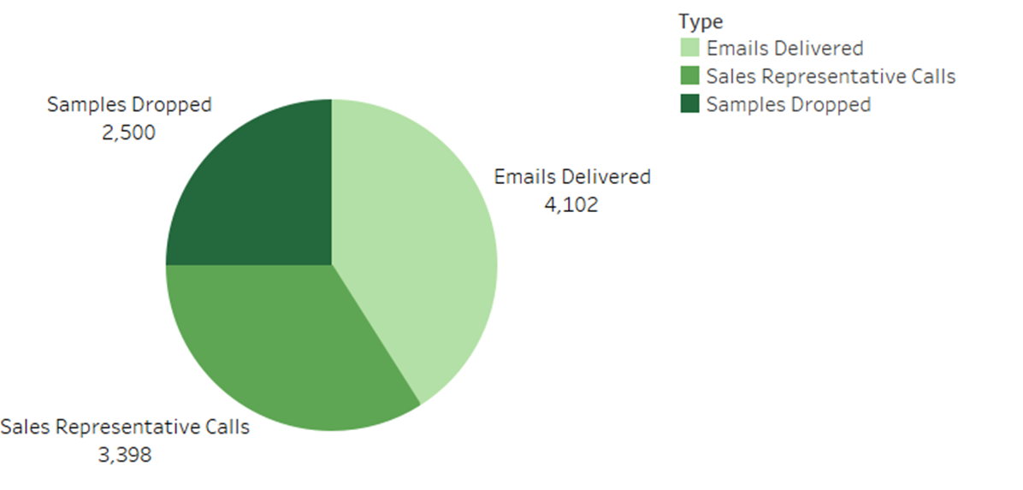
Approaches to Task - 1
D. Final Approach:
Building upon previous approach, we found that sample drop already violated the constraint before reaching the last HCP.
The final promotion strategy was decided based on the sorting scheme we designed.

Slide 16
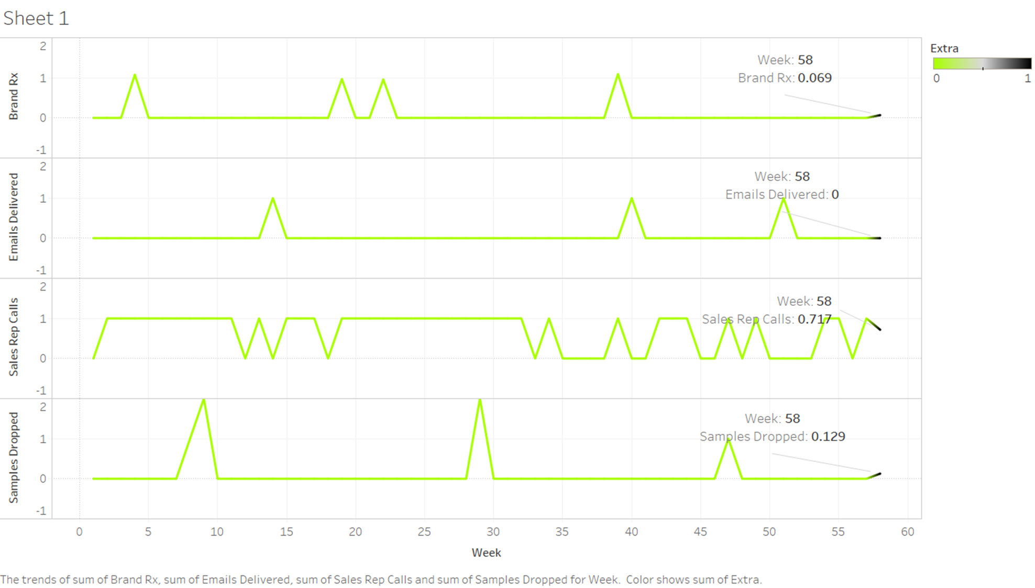

Slide 17
Task - 2 (Regression Type)
Approach 1
LSTM without constraint on Brand Rx value
LSTM with constraint on Brand Rx value
Approach 2
Approach 3
Final Approach

Slide 18
Approaches to Task - 2
A. LSTM without constraint on Brand Rx value:
For all HCPs, a deep learning model (LSTM) was applied to predict the Brand Rx value.
The 10% constraint was not satisfied.
B. LSTM with constraint on Brand Rx value (Final Approach):
Building on the previous approach, the predictions obtained were clipped to fall within the constraint.

Slide 19
04
Final Results

Slide 20
Summary
Task - 1:
The predicted distribution of promotion strategy is as follows:
Sales representative calls are 3398 and satisfy constraint based on HCP segment
Sample drops are 2500 and satisfy constraint of maximum 25% in a week
Emails are 4102
Task - 2:
The sum of Brand Rx value for the last week of Jan'20 is 6376.952
The sum of predicted Brand Rx value for the first week of Feb'20 is 6861.917
The deviation is 7.6% which satisfies the constraint of maximum of 10% variation from previous week .

Slide 21



Thank You
Harsh Sukheja
Jeevesh Mahajan
Aditya Agrawal
AKA Mike
AKA Harvey
AKA Louis

